Slide 1




Studio Shodwe
Home
Service
About Us
Contact
TECHGESTURESPEAK: ARDUINO-BASED GLOVE FOR TRANSLATING SIGN LANGUAGE INTO WORDSNOLOGY

Slide 2
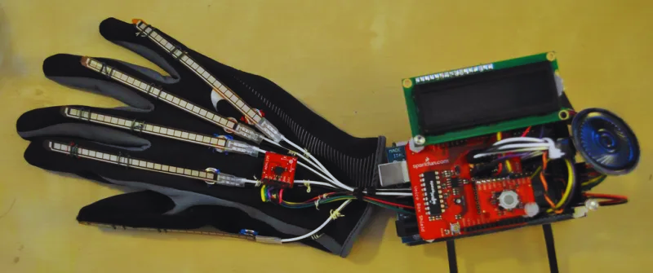
Studio Shodwe
Home
Service
About Us
Contact
INTRODUCTION
The "Sign Language Glove" project aims to provide an innovative solution for individuals with hearing or speech impairments. This project focuses on creating a wearable glove that interprets hand gestures used in sign language and translates them into text displayed on an LCD screen. The technology is simple, cost-effective, and could dramatically improve communication for users in real-time without relying on an interpreter.
The glove aims to overcome communication barriers, making it easier for people who cannot hear or speak to communicate with others who don't understand sign language. This solution is particularly useful in environments like hospitals, schools, or public spaces where accessibility is often limited.

Slide 3

Studio Shodwe
Home
Service
About Us
Contact
PROBLEM STATEMENT AND TITLE OF THE PROJECT
01
The Problem: There is a major communication gap between those who rely on sign language and those who don’t understand it. While some solutions exist, such as human interpreters or sign language apps, they can be expensive, inconvenient, or require a secondary device like a smartphone. A wearable solution is both practical and accessible for daily use.
02
Communication Barrier Between Deaf/Hard of Hearing
A large number of people who are deaf or hard of hearing rely on sign language as their primary mode of communication. However, most people who do not belong to the deaf community are not fluent in sign language, creating a communication barrier.
03
Need for a Portable, Wearable Solution
Existing technologies for sign language translation typically require external devices like phones, cameras, or computers. These tools are not always portable or convenient for everyday use. What is needed is a compact, wearable solution that allows users to communicate efficiently without the need for extra devices.

Slide 4
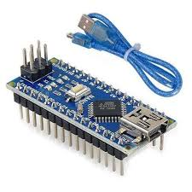
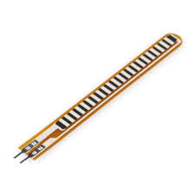
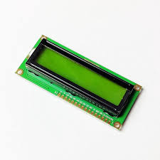
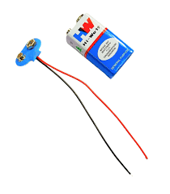
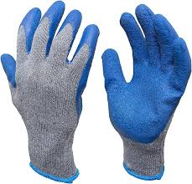
Studio Shodwe
Home
Service
About Us
Contact
IDENTIFICATION OF REQUIRED COMPONENTS
The required components for the Sign Language Glove project include an Arduino Nano microcontroller to process input from the flex sensors attached to each finger, which detect finger bends corresponding to different sign language gestures. A 16x2 LCD display is used to show the translated text output of the gestures. Power is supplied by a 9V battery connected to the circuit. Additional components include resistors to regulate current, wires for connections, and possibly a breadboard for assembling the circuit. The flex sensors, being key components, translate hand movements into electrical signals that the Arduino interprets and displays on the LCD, making this setup essential for translating sign language into readable text.

Slide 5
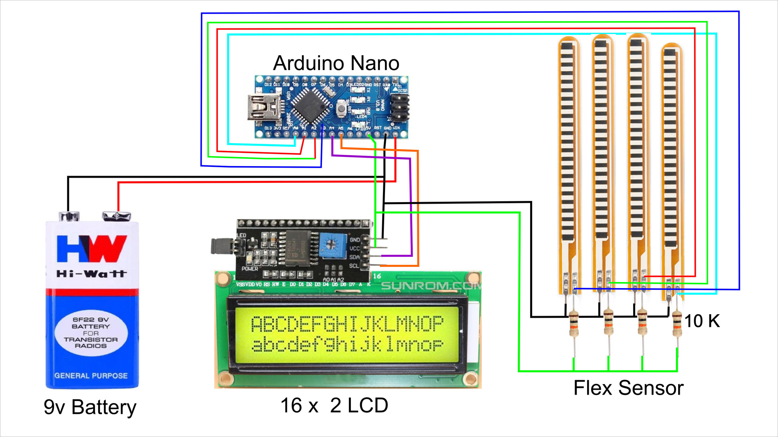
Studio Shodwe
Home
Service
About Us
Contact
PLAN OF ACTION
Before integrating into the glove, prototype the circuit on a breadboard. Connect the Arduino, flex sensor, and LCD display to ensure everything works as expected. Test whether the flex sensor can accurately read the finger movement and display corresponding text on the LCD.
01
Write and test the code for reading flex sensor data. Map the bending of the sensors to specific letters or gestures. Ensure the code is optimized for real-time use so that gestures are displayed without delay. If time allows, start planning for additional gestures
02
03
Attach the flex sensors to the fingers of the glove using tape or fabric glue. Wire the sensors to the Arduino, and carefully place the Arduino and LCD into a small, wearable box or mount that can be attached to the wrist.
02

Slide 6

Studio Shodwe
Home
Service
About Us
Contact
TIMELINE OF PROGRESS
A clear timeline is important to track milestones and ensure the project remains on schedule:
Week 1: Research the components and purchase all required materials. Begin by testing one flex sensor with the Arduino Nano and LCD to ensure proper data transmission.
Week 2: Complete circuit prototyping. Set up connections between all five flex sensors, the Arduino, and the LCD. Begin basic coding to map sensor readings to gestures.
Week 3: Refine the code for accurate gesture-to-letter mapping. Debug any issues with sensor readings. Test various sign language gestures with the glove prototype.
Week 4: Final assembly of the glove. Attach all components to the glove and conduct final testing. Prepare for a demo of the fully functioning system.
Week 5: Final adjustments, polishing the code, improving ergonomics, and preparing the glove for the project review presentation.

Slide 7
Studio Shodwe
Home
Service
About Us
Contact
GUIDED BY
DIVYA MEANAN SUNDARAM
21MIS7005 - KRISHNA MOHAN
21MIS7012 - LAKSHMAN ROHITH
21MIS7015 - PRANEETHA
21MIS7022 - MADHU ALAPAKA
21MIS7039 - K.KAARTHIKEYA
21MIS7087 - P.NIKHILESH

Slide 8
Studio Shodwe
Home
Service
About Us
Contact
THANK YOU

